Slide 1
Ethics in Information Technology, Fourth Edition
Chapter 5
Freedom of Expression

Slide 2
Objectives
As you read this chapter, consider the following questions:
  What is the basis for the protection of freedom of expression in the United States, and what types of expression are not protected under the law?
  What are some key federal laws that affect online freedom of expression, and how do they impact organizations?
  What important freedom of expression issues relate to the use of information technology?
Ethics in Information Technology, Fourth Edition

Slide 3
First Amendment Rights
Right to freedom of expression
  Important right for free people everywhere
  Guaranteed by the First Amendment
Freedom of speech. ...
Freedom of trade. ...
Upholding land reforms. ...
Equality. ...
Other amendments. ...
References. ...
External links.
Definition of free speech includes:
  Nonverbal, visual, and symbolic forms of expression,flag buring,dance movements
  Right to speak anonymously
Ethics in Information Technology, Fourth Edition

Slide 4
First Amendment Rights (cont’d.)
Not protected by the First Amendment
  Perjury:-the crime of telling lies in court when you have promised to tell the truth:
  Fraud
  Defamation:-the action of damaging the good reputation of someone
  Obscene speech:- offensive, rude, or shocking
  Incitement of panic:- the action of provoking unlawful behaviour .
  Incitement to crime
  “Fighting words”
  Sedition:-the crime of creating a revolt, disturbance, or violence against lawful civil authority with the intent to cause its overthrow or destruction
Ethics in Information Technology, Fourth Edition

Slide 5
Types of speech-Obscene Speech
Based on Miller v. California, speech is considered obscene when:
  Average person finds the work appeals to the prurient(having or encouraging an excessive interest in sexual matters) interest
  Work depicts or describes sexual conduct in an offensive way
Ethics in Information Technology, Fourth Edition

Slide 6
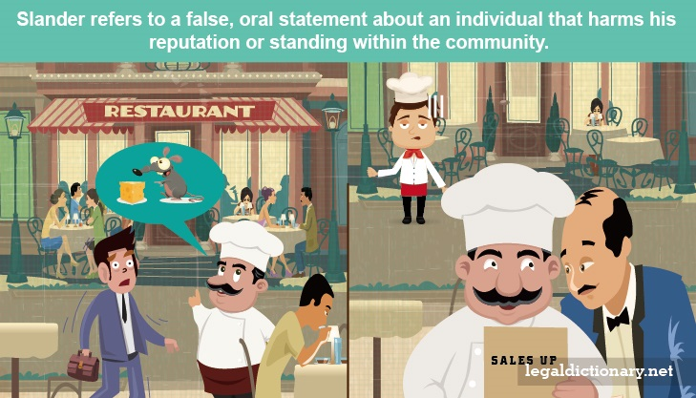
Defamation
Oral or written statement of alleged fact that is:
  False
  Harms another person
    Harm is often of a financial nature
Slander
  Oral defamatory statement
  Spoken words or gestures.
Libel
Statement made in some permanent form
Writing,printing,picture or statue
  Written defamatory statement
Ethics in Information Technology, Fourth Edition

Slide 7
Freedom of Expression: Key Issues
Controlling access to information on the Internet
Anonymity on the Internet (freedom to express without revealing their identity
Doxing to track them(The act of revealing identifying information about someone online — their real name, address, workplace, phone number, or other identifying information — is known as doxing (also spelled “doxxing”).)
Defamation and hate speech
Corporate blogging
Pornography
Ethics in Information Technology, Fourth Edition

Slide 8
Controlling Access to Information on the Internet
Freedom of speech on the Internet is complicated by ease by which children can access Internet
Communications Decency Act (CDA)
  Aimed at protecting children from pornography
Ethics in Information Technology, Fourth Edition

Slide 9
Controlling Access to Information on the Internet (cont’d.)
Child Online Protection Act (COPA)
  Applies to communication for commercial purposes
  Imposes penalties for exposing minors to harmful material on the Web
Internet filtering
  Software installed with a Web browser
  Blocks access to certain Web sites deemed to contain inappropriate or offensive material
Ethics in Information Technology, Fourth Edition

Slide 10
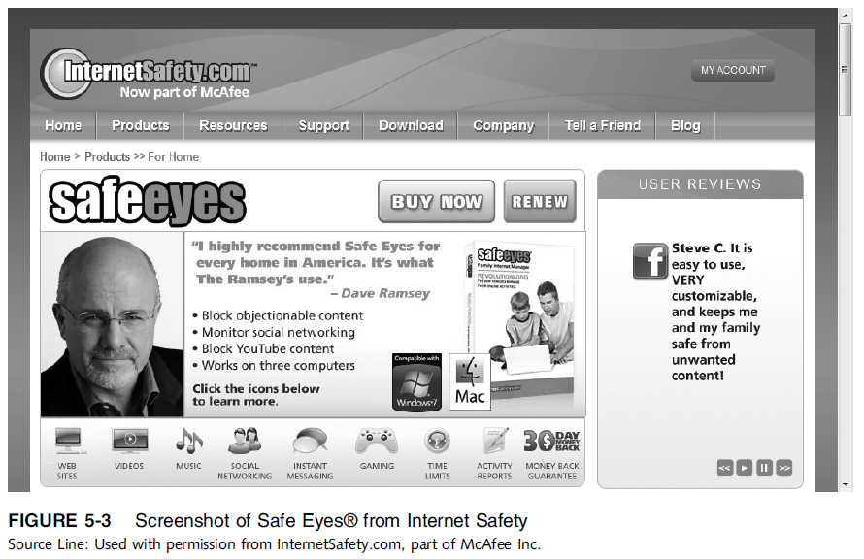
Ethics in Information Technology, Third Edition
Ethics in Information Technology,

Slide 11
Controlling Access to Information on the Internet (cont’d.)
URL filtering
  Blocks objectionable URLs or domain names
Keyword filtering
  Blocks keywords or phrases
Dynamic content filtering
  Web site’s content is evaluated immediately before being displayed
Ethics in Information Technology, Fourth Edition

Slide 12
Controlling Access to Information on the Internet (cont’d.)
Top-rated Internet filters for home users
McAfee Safe Eyes. ...
McAfee Family Protection. ...
PureSight Owl. ...
CYBERsitter. ...
CyberPatrol. ...
Profil Parental Filter. ...
imView.
Ethics in Information Technology, Fourth Edition

Slide 13
Controlling Access to Information on the Internet (cont’d.)
ICRA(internet content rating association)system
  Questionnaire for Web authors
  The web author is asked whether specific items or features are present on sites.
  Based on response ICRA generates a content label
  (short piece of computer code)that author adds to this site.
  It conforms to internet industry standard known Platform for Internet Content Selection (PICS)
  Internet users can then set their browser to allow or disallow access to Websites based on info declared in the content label
Ethics in Information Technology, Fourth Edition

Slide 14
Controlling Access to Information on the Internet (cont’d.)
ISP blocking
  Blocking is performed on the ISP server
  ClearSail/Family.NET prevents access to certain Web sites that address topics like bomb making,hacking,suicide,public chat.
Ethics in Information Technology, Fourth Edition

Slide 15
Children’s Internet Protection Act (CIPA)
Federally financed schools and libraries must block computer access to:
  Obscene material
  Pornography
  Anything considered harmful to minors
Ethics in Information Technology, Fourth Edition

Slide 16
Children’s Internet Protection Act (CIPA)
Schools and libraries subject to CIPA do not receive Internet access discounts unless they:
  Put in place measures to filter pictures that are obscene, contain child pornography, or are harmful to minors
  Adopt a policy to monitor the online activities of minors
  Adopt a policy restricting minors’ access to materials harmful to them
Ethics in Information Technology, Fourth Edition

Slide 17
Children’s Internet Protection Act (CIPA) (cont’d.)
CIPA does not require the tracking of Internet use by minors or adults
Acceptable use policy agreement is an essential element of a successful program in schools
  Signed by:
    Students
    Parents
    Employees
Ethics in Information Technology, Fourth Edition

Slide 18
Anonymity on the Internet
Anonymous expression is expression of opinions by people who do not reveal their identity
Freedom to express an opinion without fear of reprisal is an important right in democratic society
Anonymity is even more important in countries that do not allow free speech
Played important role in early formation of U.S.
In the wrong hands, it can be a tool to commit illegal or unethical activities(example SARAHAH)
Ethics in Information Technology, Fourth Edition

Slide 19
Anonymity on the Internet (cont’d.)
Anonymous( unknown name) remailer service
  Computer program that strips the originating address from the email message
  Forwards the message to the intended recipient
  Ensures no header information can identify the author
  Keeps what is communicated anonymous
  What is communicated and whether it is ethical or unethical, legal or illegal, is up to the sender
  An anonymous remailer is a server that receives messages with embedded instructions on where to send them next, and that forwards them without revealing where they originally came from.
Ethics in Information Technology, Fourth Edition

Slide 20
Anonymity on the Internet (cont’d.)
John Doe lawsuit
  Defendant communicates using anonymously so identity of defendant is temporarily unknown
  - Once John Doe lawsuit is filed, the company may request court permission to issue subpoenas
  ISPs frequently require (a document or other evidence) to be submitted to a court of law. to provide the identity of anonymous “John Does”
  Anonymity on the Internet cannot be guaranteed
  https://www.youtube.com/watch?v=yXcSpHuZiaw
Ethics in Information Technology, Fourth Edition

Slide 21
Defamation and Hate Speech
Hate speech that can be prosecuted includes:
  Clear threats and intimidation against specific citizens
  Sending threatening private messages over the Internet to a person
  Displaying public messages on a Web site describing intent to commit acts of hate-motivated violence against specific individuals
  Libel directed at a particular person
Ethics in Information Technology, Fourth Edition

Slide 22
Defamation and Hate Speech (cont’d.)
Many ISPs reserve right to remove content that does not meet their standards
Such actions do not violate the subscriber’s First Amendment rights because these prohibitions are in the terms of service
  ISPs must monitor the use of their service
  Take action when terms are violated
Ethics in Information Technology, Fourth Edition

Slide 23
Corporate Blogging
Some organizations allow employees to create their own personal blogs to:
  Reach out to partners, customers, and employees
  Improve their corporate image
Blogs can provide uncensored commentary and interaction
  Criticism of corporate policies and decisions
Could involve risk that employees might:
  Reveal company secrets
  Breach federal security disclosure laws
Ethics in Information Technology, Fourth Edition

Slide 24
Pornography
The Internet has been a boon to the pornography industry
  More than 4.2 million porn Web sites are accessible
  The sites generate an estimated $1 to $7 billion a year in revenue
  72 million estimated visitors to porn Web sites monthly
Individuals free to produce and publish what they want; however, if what they distribute is judged obscene, they are subject to prosecute
  California v Miller set precedent for what is obscene
Ethics in Information Technology, Fourth Edition

Slide 25
Pornography (cont’d.)
Many organizations take steps to stop access in the workplace
  Establishing a computer usage policy that prohibits access to pornography sites
  Identifying those who violate the policy
  Taking action against those users
  Failure to take action against pornography could result in sexual harassment lawsuit
Ethics in Information Technology, Fourth Edition

Slide 26
Pornography (cont’d.)
Sexting is sending of sexual messages photos, or sexually explicit videos over a cell phone
  Fast-growing trend
CAN-SPAM Act
The Controlling the Assault of Non-Solicited Pornography And Marketing (CAN-SPAM) Act of 2003, signed into law by President George W. Bush on December 16, 2003,
  Specifies requirements that commercial retailers must follow when sending messages
  * “from and to” must be accurate and identify the person who initiated email.
  The email must be identified as an ad and should include a valid physical postal address for the sender.
  The subject line of the email cannot mislead the recipient as to the contents or subject matter of the message.
  Each violation can result in $250 - $750 fine
  https://www.law.cornell.edu/wex/inbox/can-spam_act_core_requirements
Ethics in Information Technology, Fourth Edition

Slide 27
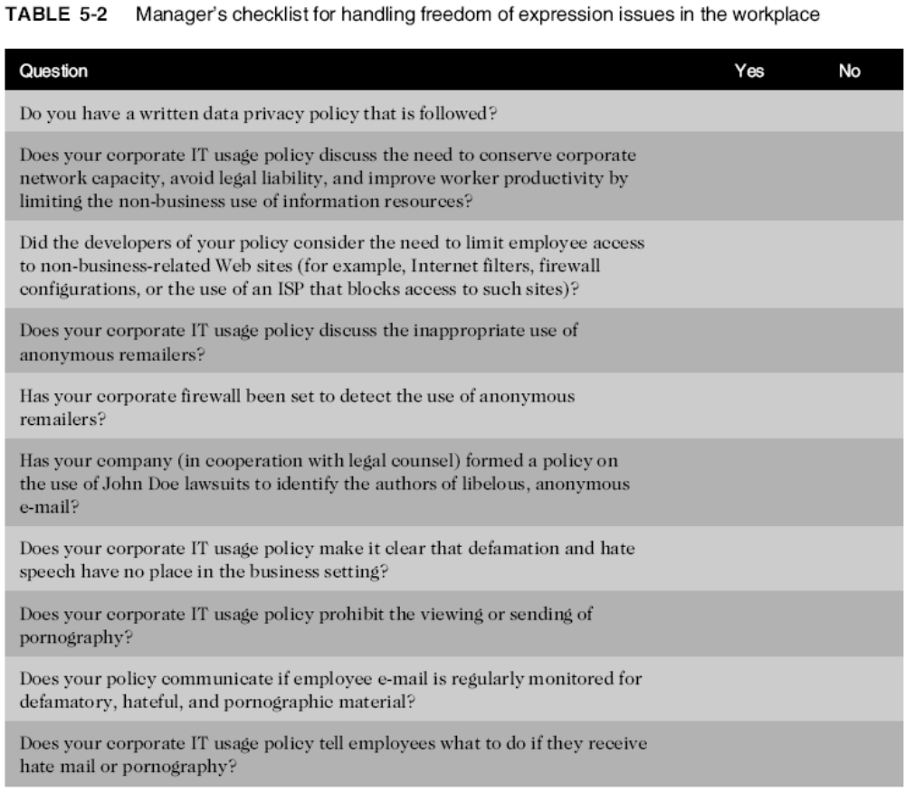
Ethics in Information Technology, Fourth Edition

Slide 28
Mcq
An important Supreme Court case that established a three-part test to determine if material is obscene and therefore not protected speech was____
a. COPA
b. Miller Vs California
c. CIPA
d. None of the above
The best Internet filters rely on the use of:
a. URL filtering
b. keyword filtering
c. dynamic content filtering
d. all of the above
Ethics in Information Technology, Fourth Edition

Slide 29
The California States Court in Pre-Paid Legal vs Sturtz et al. set a precedent that courts apply when deciding whether to approve subpoenas requesting the identity of _____
a. John Doe lawsuit
b. Miller vs California
c. anonymous Internet speakers
d. COPA
Key issues for Freedom Of Expression
a. Pornography
b. Hacking
c. Defamation
d. Both a & c
Ethics in Information Technology, Fourth Edition

Slide 30
Summary
First Amendment protects the right to:
  Freedom of religion and expression
Does not protect obscene speech, defamation
Key issues
  Controlling access to Internet information, especially for children
  Anonymous communication
  Spread of defamation and hate speech
  Access to pornography
  CAN-SPAM Act limitations on email messages
Ethics in Information Technology, Fourth Edition

